Slide 1
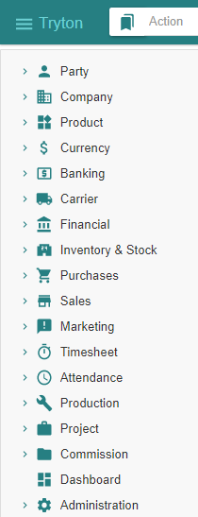
- Getting started - Administration
Tryton By Example
Github - https://github.com/clixwise/tryton-by-example Version of presentation : 6.0 Version of Tryton : 6.0 Verified for execution on : Windows 10 & Powershell 7 Licence : CC BY 4.0 Author : Marc Rottiers

Slide 2
Foreword
This presentation aims to expedite the process of learning the basics of the TRYTON ERP. It rests on a personal initiative. The content does not replace official TRYTON documentation in any manner. First-time end-users who want to explore this package should benefit the most. System administration aims at running a demonstration environment without further consideration for performance, security, etc. Production-grade system setup and usage will probably differ from exposed techniques that are meant to keep the explanations as concise as possible.
The material relates to TRYTON 6.0 on Windows 10 Home. There is no warranty that the same results will or can be achieved using a different setup. In particular, the author cannot take responsibility for loss or corruption of data that would result from handling processes based on given information.
Are described an installation procedure as well as some use cases by example. There are explanatory documents as well as accompanying database samples and ancillary scripts.
The author acknowledges documentation that he had the opportunity to analyse for the purpose of creating the present material. Special credit and thanks to @ced, @pokoli, @dave, @edbo who provide support on the https://discuss.tryton.org/ forum. Feedback is appreciated. Please post on https://github.com/clixwise/tryton-by-example

Slide 3
Structure of material
Topics
Tryton 6.0 - Doc 00.01 - Installation & administration
Tryton 6.0 - Doc 05.01 - Basic functionality
Tryton 6.0 - Doc 10.01 - Purchase
Tryton 6.0 - Doc 15.01 - Sale
Tryton 6.0 - Doc 80.01 - Ancillaries

Slide 4
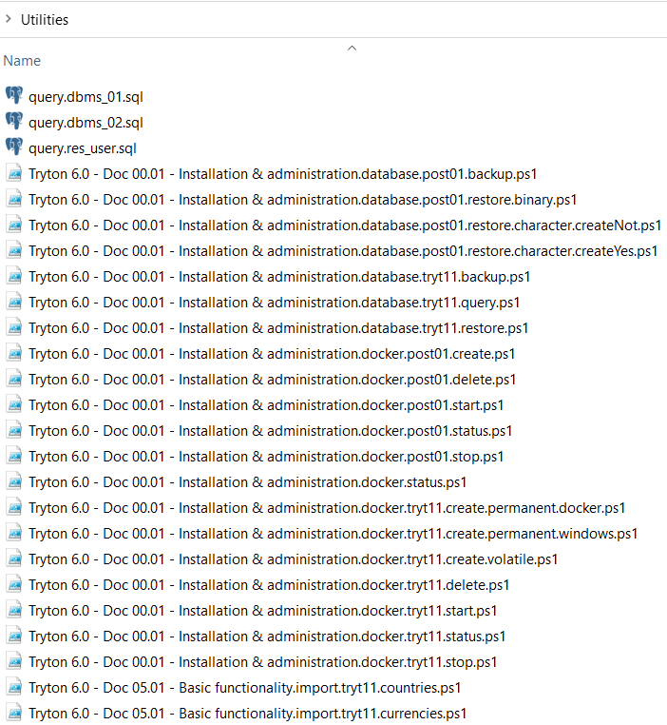
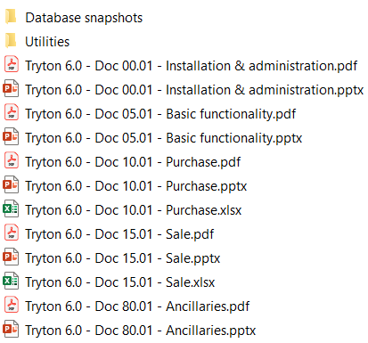
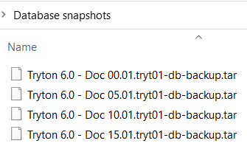
Structure

Slide 5
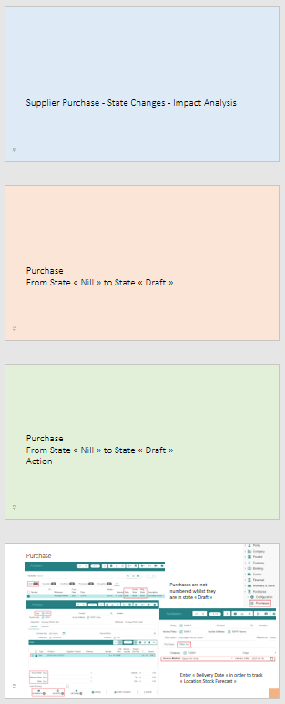
Slides
We use the following color conventions to separate the different (sub)sections in each presentation
Level 1 section - Heading
Level 2 section - Heading
Level 3 section - Heading
Level 4 section - Text

Slide 6
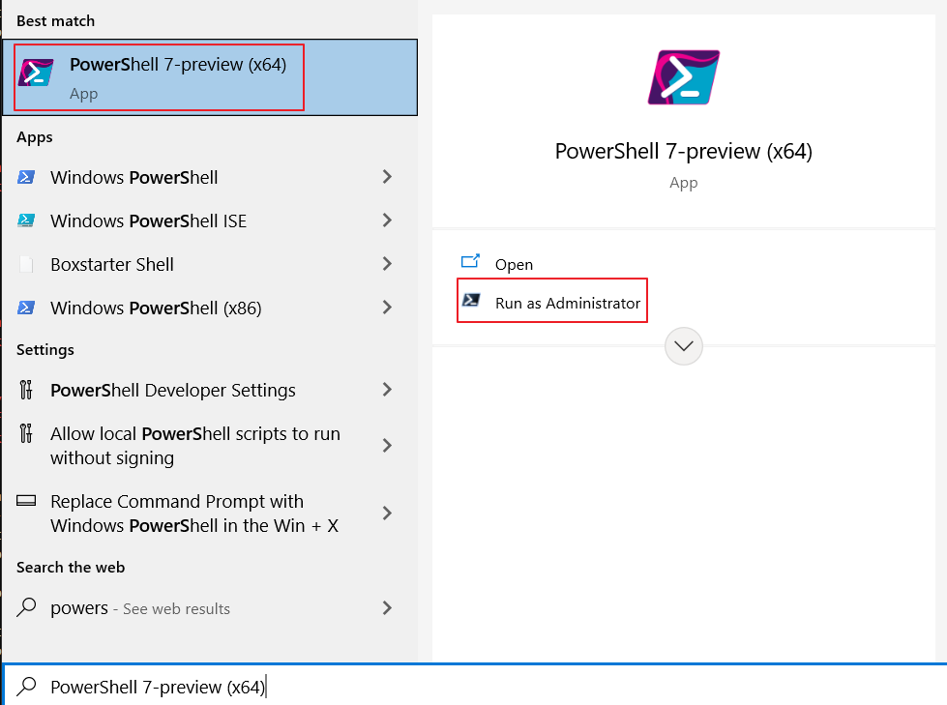
Scripts
Powershell scripts « *.ps1 » are provided in the folder « Utilities » to support routine operations
Powershell can be accessed as shown below
Each script needs some tuning e.g. with respect to the database name, etc.
Powershell scripts are executed as follows :
In their folder e.g. : ./"Tryton 6.0 - Doc 01.01 - Installation & administration.docker.status"
In File Explorer : « Run with Powershell »

Slide 7
Database snapshots
We have taken a snapshot at the end of each presentation section (Basic Functionality, Purchase, etc.)
File name
Tryton 6.0 - Doc 00.01.tryt01-db-backup.tar | Database state at end of « 00.01 »
Tryton 6.0 - Doc 05.01.tryt01-db-backup.tar | Database state at end of « 05.01 »
Tryton 6.0 - Doc 10.01.tryt01-db-backup.tar | Database state at end of « 10.01 »
Tryton 6.0 - Doc 15.01.tryt01-db-backup.tar | Database state at end of « 15.01 »

Slide 8
Table of Contents

Slide 9
TOC
CONTAINERS Docker Installation
Container Installation
Tryton - « Permanent » Data
Tryton - « Volatile » Data
Postgres - « Permanent » Data
Container Management
Container Uninstallation
Container Multi-versioning
System Reboot CLIENT User Interface PgAdmin4
Tryton DATABASES
Operations
Tryton & Postgres Backup
Tryton & Postgres
Restore
Tryton & Postgres
Multi-database Container
Tryton
SUMMARY Next
Issues References
Installing Docker on Windows
How to install containers
Installing Tryton with data residing on volume outside of container
Installing Tryton with data inside of container
Installing Postgres with data on volume outside of container
How to manage containers
How to uninstall containers
How to install containers from multiple image versions
How to proceed after system reboot Interface to TRYTON & PGADMIN
Setting up & Exploring the pgadmin4 interface
Logging & Logout
Working with the database
Backing up the database (UTF-8 compliant)
Restoring the database (UTF-8 compliant)
Managing multiple databases in a Database Container Next topics
Documentation points still to be resolved
Links of interest
In blue essential information relative to TRYTON
Consider other sections if unfamiliar with Docker or Postgres

Slide 10
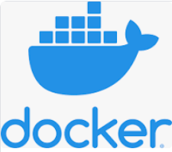
Docker Installation

Slide 11
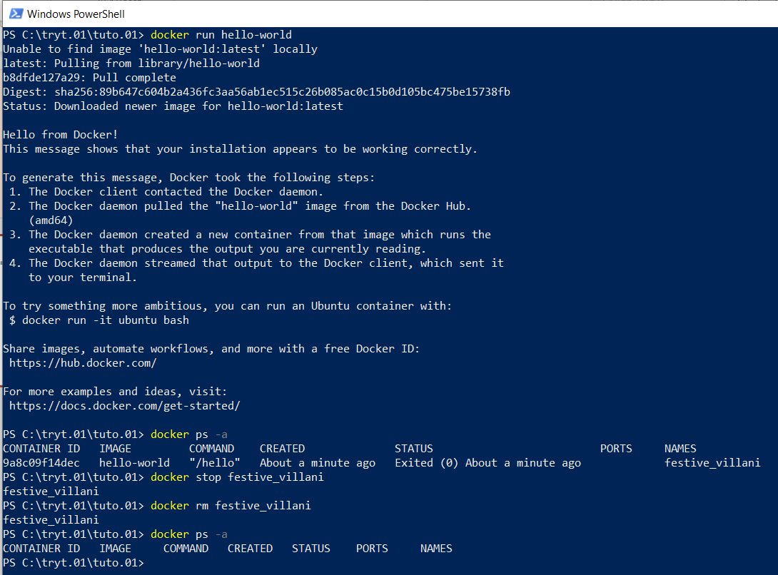
Installation
Context Windows 10 & Powershell 7
Remark
We do not use WSL2 Download See https://docs.docker.com/get-docker/ Control
Run « docker run hello-world »

Slide 12
Motivation
- The aim for this presentation is to explore the

Slide 13
Container Installation

Slide 14
Motivation
We install two series of Docker containers :
Series 1 is about the TRYTON ERP system : its server application, its database and file systems
Series 2 is about managing POSTGRES databases and interfacing them using « pgAdmin4 »
Series 1 is compulsory since it is helps you practice the TYTON system
Series 2 is optional as it only helps understanding how TRYTON uses the underlying database

Slide 15
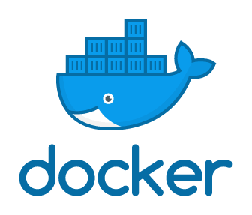

Structure
- TRYTON is accessed by default using « localhost:8000 » for « TRYTON »
- POSTGRES is accessed by default using « localhost:80 » for « pgAdmin4 »
Browser
TRYTON User Interface
PGADMIN4 User Interface
Application Container
Application Container
Tryton Containers
Postgres & pgadmin4 Containers
Database & File Container
Database Container
Tryton
Postgres
Optional
Postgres
TRYTON Docker Structure
POSTGRES Docker Structure (optional)

Slide 16
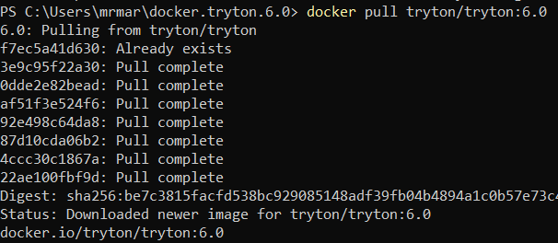
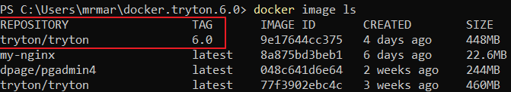
Docker Image
Docker Containers are installed from Docker Images
Docker Images are « pulled » from a Docker Hub
This presentation pertains to TRYTON 6.0
So make sure to « pull » the correct image version by using : « docker pull tryton/tryton:6.0 »
If you do « docker pull tryton/tryton », you pull the « latest » image version (tag)
Verify using « docker image ls »

Slide 17
Commands
https://docs.docker.com/reference/
Check installation
docker run hello-world | Check installation is operational
Container commands
docker ps -a | List containers
docker stop a_container_name | Stop a container
docker start a_container_name | Start a container
docker rm a_container_name | Remove a stopped container
docker logs a_container_name | Output the logs produced by the container
docker container prune | Remove stopped containers

Slide 18
Commands
Volume commands
docker volume create a_volume_name | Create a volume
docker volume ls | List the volumes
docker volume rm a_volume_name | Remove a volume
docker volume prune | Remove all unreferenced volumes. « Unreferenced » = not referenced by container
docker volume rm | Remove all unused volumes. « Unused » = not used by container
docker volume inspect a_volume_name | Inspect a volume
Volume commands
docker network create a_network_name | Create a network
docker network ls | List the networks
docker network rm a_network_name | Remove a network
docker network prune | Remove all unreferenced networks. « Unreferenced » = not referenced by container
docker network rm | Remove all unused networks. « Unused » = not used by container
docker network inspect a_network_name | Inspect a network

Slide 19
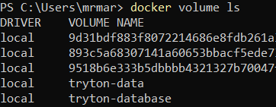
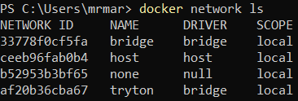
Commands
Other commands
docker system prune | Remove all unused containers, networks, images (both dangling and unreferenced), and optionally, volumes.

Slide 20
Docker Containers and their Host Environment
Installing TRYTON ERP Containers The TRYTON « Database & File Container » can be installed in one of two ways with respect to database and files permanence :
- In a « permanent » setup. It means that the database and any « attachment » files are maintained in the host environment i.e. in the Windows file system and not in the container itself. They will thus remain available when the corresponding Docker container is removed, accidentally or not.
- In a « semi-permanent » setup. It means that, if we delete the Docker container, the TRYTON database will disappear together with any « attachment » files storing information alongside the database.
Installing POSTGRES Containers
The same remark applies with respect to whether the database is stored in the container or in a mounted volume.
Convention about password names
Everywhere a password is needed we give it the value « Password »

Slide 21
Tryton - « Permanent » Data

Slide 22
Principle
Install :
A container « tryt11-postgres » from docker image « postgres » ; « -p 5434: » can be changed (default : 5432)
A container « tryt11 » from docker image « tryton/tryton » ; « -p 8001: » can be changed (default : 8000)
Two volumes : « tryt11-database » & « tryt11-datafile »
One network : « tryt11-network »
A nameless container is used to initialize the TRYTON database.
The location where the volumes for the TRYTON database and the TRYTON files (binary attachments) are stored :
Subfolder « tryt11-database » with respect to the directory (Get-Location) where the Powershell script executes
Subfolder « tryt11-datafile » with respect to the directory (Get-Location) where the Powershell script executes
Server Container « tryt11 »
TRYTON Docker Structure
Tryton Containers
Database Container « tryt11-postgres »
TRYTON File Structure
Tryton Folders
« tryt11-database »
« tryt11-datafile »
TRYTON
Refer to :
https://stackoverflow.com/questions/18496940/how-to-deal-with-persistent-storage-e-g-databases-in-docker
https://docs.docker.com/storage/volumes/

Slide 23
Scripts
Docker Powershell Commands - Run as ./"..."
Tryton 6.0 - Doc 00.01 - Installation & administration.docker.status | Query status
Tryton 6.0 - Doc 00.01 - Installation & administration.docker.tryt11.create.permanent.docker (*) | Create « tryt11 » containers Permanent data when containers removed Permanent data inside docker volume (faster)
Tryton 6.0 - Doc 00.01 - Installation & administration.docker.tryt11.create.permanent.windows (*) | Create « tryt11 » containers Permanent data when containers removed Permanent data inside windows volume (slower)
Tryton 6.0 - Doc 00.01 - Installation & administration.docker.tryt11.create.volatile | Create « tryt11 » containers Volatile data when containers removed
Tryton 6.0 - Doc 00.01 - Installation & administration.docker.tryt11.start | Start « tryt11 » containers
Tryton 6.0 - Doc 00.01 - Installation & administration.docker.tryt11.stop | Stop « tryt11 » containers
Tryton 6.0 - Doc 00.01 - Installation & administration.docker.tryt11.status | Query status of « tryt11 » containers
Tryton 6.0 - Doc 00.01 - Installation & administration.docker.tryt11.delete | Delete « tryt11 » containers
« Docker » database and file permanency is recommended for two reasons :
Database handling by the application system is faster when stored on a Docker volume
Accessing files on a Windows volume from inside a Docker container requires a cross-environment user authorisation setup

Slide 24
./"Tryton 6.0 - Doc 00.01 - Installation & administration.docker.tryt11.create.permanent.docker"
docker pull tryton/tryton:6.0
docker network create tryt11-network
docker volume create tryt11-database
docker volume create tryt11-datafile
$POSTGRES_PASSWORD ="Password"
# tryt11 database container
docker run --name tryt11-postgres --env PGDATA=/var/lib/postgresql/data/pgdata --env POSTGRES_DB=tryt11 --env POSTGRES_PASSWORD=${POSTGRES_PASSWORD} --mount source=tryt11-database,target=/var/lib/postgresql/data --network tryt11-network -p 5443:5432 --detach postgres
Start-Sleep -Seconds 30 # Replace by detecting database is 'up'
# docker exec -tiu postgres tryt11-postgres psql -c '\l+'
# tryt11 transient container to initialize the tryt11 database in its container
docker run --env DB_HOSTNAME=tryt11-postgres --env DB_PASSWORD=${POSTGRES_PASSWORD} --network tryt11-network --interactive --tty --rm tryton/tryton trytond-admin -d tryt11 --all
# tryt11 server containers : tryt11 & optionally tryt11-cron for scheduled actions
docker run --name tryt11 --env DB_HOSTNAME=tryt11-postgres --env DB_PASSWORD=${POSTGRES_PASSWORD} --mount source=tryt11-datafile,target=/var/lib/trytond/db --network tryt11-network -p 8011:8000 --detach tryton/tryton
Refer to :
[https://discuss.tryton.org/t/how-to-run-tryton-using-docker/3200] with special credits to David Harper

Slide 25
./"Tryton 6.0 - Doc 00.01 - Installation & administration.docker.tryt11.create.permanent.windows"
docker pull tryton/tryton:6.0
docker network create tryt11-network
$POSTGRES_PASSWORD ="Password" # Tryton database container – Create $TRYTON_VOL_DB = (Get-Location).tostring().replace("\","/").replace("C:/","c//") + "/"+"tryt11-database" # docker volume create tryt11-database - for future use
docker run --name tryt11-postgres --env PGDATA=/var/lib/postgresql/data/pgdata --env POSTGRES_DB=tryt11 --env POSTGRES_PASSWORD=${POSTGRES_PASSWORD} --volume ${TRYTON_VOL_DB}:/var/lib/postgresql/data --network tryt11-network -p 5443:5432 --detach postgres Start-Sleep -Seconds 20 # required to wait for postgres to properly connect docker exec -tiu postgres tryt11-postgres psql -c '\l+' dir # Tryton transient container to initialize the tryton database in its container
docker run --env DB_HOSTNAME=tryt11-postgres --env DB_PASSWORD=${POSTGRES_PASSWORD} --network tryt11-network --interactive --tty --rm tryton/tryton:6.0 trytond-admin -d tryt11 --all docker exec -tiu postgres tryt11-postgres psql -c '\l+'
# Tryton server container $TRYTON_VOL_FI = (Get-Location).tostring().replace("\","/").replace("C:/","c//") + "/"+"tryt11-datafile" # docker volume create tryt11-datafile - for future use
docker run --name tryt11 --env DB_HOSTNAME=tryt11-postgres --env DB_PASSWORD=${POSTGRES_PASSWORD} --volume ${TRYTON_VOL_FI}:/var/lib/trytond/db --network tryt11-network --publish 127.0.0.1:8011:8000 --detach tryton/tryton:6.0 dir
# Obtain Gateway address for usage in pgadmin4 - creating server docker inspect tryt11-postgres -f "{{json .NetworkSettings.Networks }}" # "Gateway":"172.18.0.1","IPAddress":"172.18.0.2"

Slide 26
Tryton - « Volatile » Data

Slide 27
./"Tryton 6.0 - Doc 00.01 - Installation & administration.docker.tryt11.create.volatile"
# Obtain version 6.0 of Tryton
docker pull tryton/tryton:6.0 # Tryton database container + database initialization volatile container docker run --name tryt11-postgres -e POSTGRES_PASSWORD=Password -e POSTGRES_DB=tryt11 -p 5443:5432 -d postgres # Start a PostgreSQL instance
docker run --link tryt11-postgres:postgres -e DB_PASSWORD=Password -it tryton/tryton:6.0 trytond-admin -d tryt11 --all # Define database tables
# Tryton server containers : tryton & optionally tryton-cron for scheduled actions docker run --name tryt11 -p 8011:8000 --link tryt11-postgres:postgres -e DB_PASSWORD=Password -d tryton/tryton:6.0 # Start a Tryton instance
docker run --name tryt11-cron --link tryt11-postgres:postgres -e DB_PASSWORD=Password -d tryton/tryton:6.0 trytond-cron -d tryt11 # Start a cron instance
# Obtain Gateway address for usage in pgadmin4 - creating server docker inspect tryt11-postgres -f "{{json .NetworkSettings.Networks }}" # "Gateway":"172.18.0.1","IPAddress":"172.18.0.2"
In blue, container and database variable names that can be choosen In red, connection points whose external « p:xyz » can be adapted
Note about « docker inspect tryt11-postgres » : the « Gateway":"172.17.0.1" or the "IPAddress":"172.17.0.2" will be used in « pgAdmin4 » to set up the server Note about « pgAdmin4 » login (see later) values defined in the script : - User : « x@gmail.com
- Password : « Password »

Slide 28
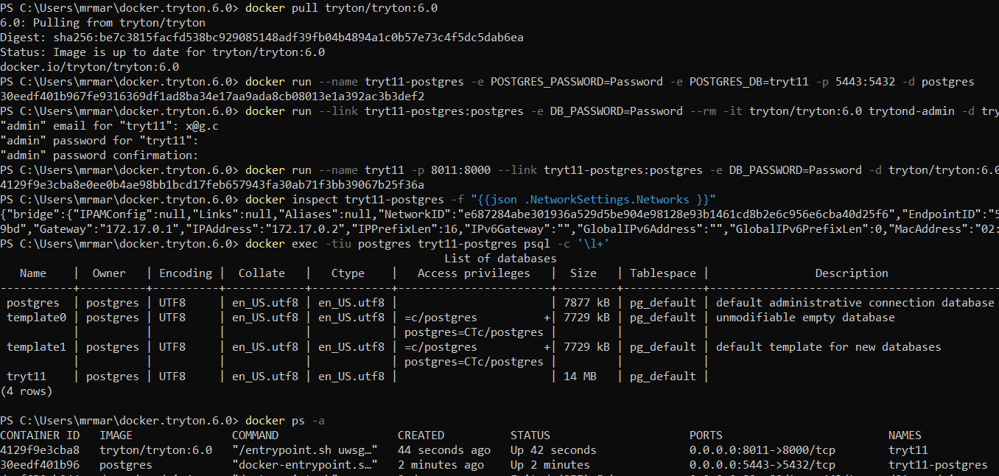

Slide 29
Postgres - « Permanent » Data

Slide 30
Principle
Install :
A container « post01-postgres » from docker image « postgres » ; « -p 5433: » can be changed (default : 5432)
A container « post01-pgadmin » from docker image « dpage/pgadmin4 » ; « -p 81: » can be changed (default : 80)
The POSTGRES database is stored in subfolder « post01-postgres » with respect to the directory ${HOME} == USER
Server Container « pgadmin4 »
POSTGRES Docker Structure
Postgres Containers
Database Container « post01-postgres »
POSTGRES File Structure
Postgres Folder
« d01-postgres »
POSTGRES
See : [https://dev.to/shree_j/how-to-install-and-run-psql-using-docker-41j2]

Slide 31
Scripts
Database Powershell Command - Run as ./"..."
Tryton 6.0 - Doc 00.01 - Installation & administration.docker.post01.create | Create Postgres & Pgadmin Containers
Tryton 6.0 - Doc 00.01 - Installation & administration.docker.post01.delete | Delete Postgres & Pgadmin Containers & Database
Tryton 6.0 - Doc 00.01 - Installation & administration.docker.post01.start | Start Postgres & Pgadmin Containers
Tryton 6.0 - Doc 00.01 - Installation & administration.docker.post01.stop | Stop Postgres & Pgadmin Containers
Tryton 6.0 - Doc 00.01 - Installation & administration.docker.post01.status | Query status of Postgres & Pgadmin Containers

Slide 32
./"Tryton 6.0 - Doc 00.01 - Installation & administration.docker.post01.create"
Install :
A container « post01-postgres » from image « postgres » ; « -p 5433: » can be changed
A container « post01-pgadmin » from image « dpage/pgadmin4 » ; « -p 81: » can be changed
# postgres docker pull postgres docker run -d --name post01-postgres -e POSTGRES_PASSWORD=Password -v ${HOME}/postgres-data/:/var/lib/postgresql/data -p 5433:5432 postgres
# pgdamin4 docker pull dpage/pgadmin4 docker run -p 81:80 -e 'PGADMIN_DEFAULT_EMAIL=x@gmail.com' -e 'PGADMIN_DEFAULT_PASSWORD=Password' --name post01-pgadmin -d dpage/pgadmin4
# inspection docker exec post01-postgres ls /var/lib/postgresql/data docker exec -tiu postgres post01-postgres psql -c '\l+'
docker inspect post01-postgres -f "{{json .NetworkSettings.Networks }}"
docker inspect -f "{{range.NetworkSettings.Networks}}{{.IPAddress}}{{end}}" post01-postgres docker inspect -f '{{.Name}} - {{.NetworkSettings.IPAddress }}' $(docker ps -aq)
Note about « docker inspect post01-postgres » : the « Gateway":"172.17.0.1" or the "IPAddress":"172.17.0.2" (e.g.) will be used in « pgAdmin4 » to set up the server Note about « pgAdmin4 » login (see later) values defined in the script : - User : « x@gmail.com
- Password : « Password »

Slide 33
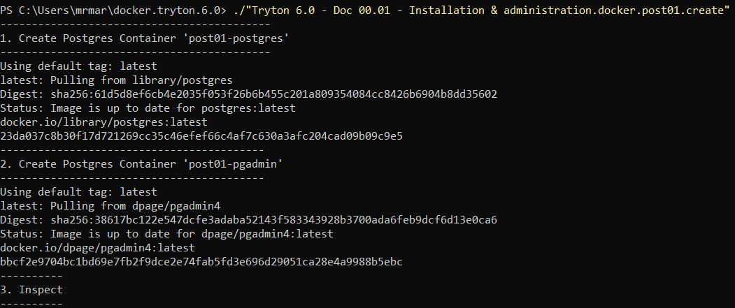
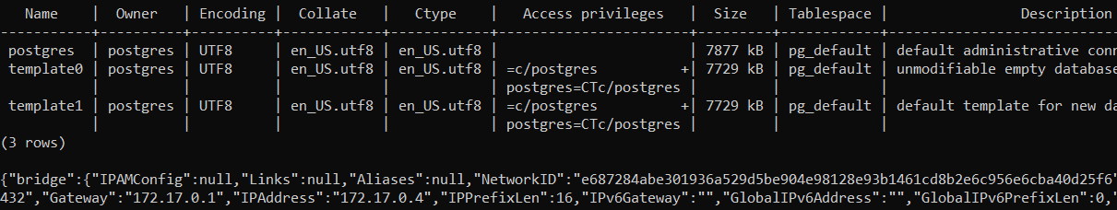
./"Tryton 6.0 - Doc 00.01 - Installation & administration.docker.post01.create"

Slide 34
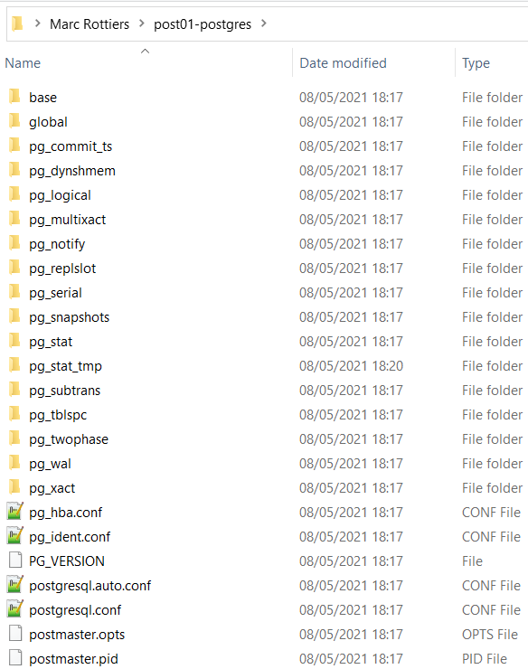
Postgres in Host
The « post01-postgres » directory is created under my user name home directory and not inside a docker container.

Slide 35
Container Management

Slide 36
Tryton Containers : Start - Stop - Status

Slide 37
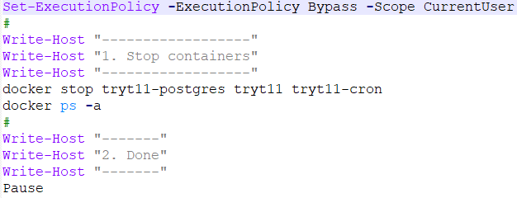
./"Tryton 6.0 - Doc 00.01 - Installation & administration.docker.tryt11.stop"

Slide 38
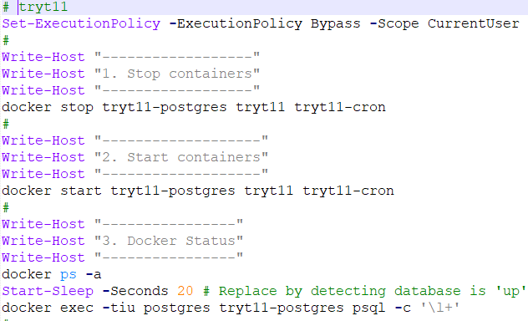
./"Tryton 6.0 - Doc 00.01 - Installation & administration.docker.tryt11.start"

Slide 39
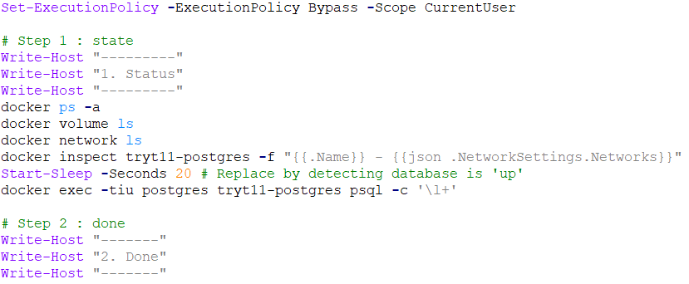
./"Tryton 6.0 - Doc 00.01 - Installation & administration.docker.tryt11.status"

Slide 40
Container Uninstallation

Slide 41
Motivation
This section explains how to delete installed containers should they be reinstalled
If the installation proceeds according to plan, the section can be skipped for later

Slide 42
Tryton

Slide 43
./"Tryton 6.0 - Doc 00.01 - Installation & administration.docker.tryt11.delete"
Write-Host "---------"
Write-Host "1. Status"
Write-Host "---------"
docker ps -a
docker network ls
docker volume ls
dir
#
Write-Host "--------------------"
Write-Host "2. Delete all tryt11"
Write-Host "--------------------"
docker stop tryt11-postgres tryt11 tryt11-cron
docker rm tryt11-postgres tryt11 tryt11-cron
docker network rm tryt11-network
docker volume rm tryt11-database tryt11-datafile
Remove-Item -Recurse -Force tryt11-database
Remove-Item -Recurse -Force tryt11-datafile
#
Write-Host "---------"
Write-Host "3. Status"
Write-Host "---------"
docker ps -a
docker network ls
docker volume ls
dir
#
Write-Host "-------"
Write-Host "4. Done"
Write-Host "-------"

Slide 44
Postgres

Slide 45
./"Tryton 6.0 - Doc 00.01 - Installation & administration.docker.post01.delete"
Write-Host "---------"
Write-Host "1. Status"
Write-Host "---------"
docker ps -a
docker network ls
docker volume ls
dir
#
Write-Host "----------------------------------------------"
Write-Host "2. Delete all post01-postgres & post01-pgadmin"
Write-Host "----------------------------------------------"
docker stop post01-postgres post01-pgadmin
docker rm post01-postgres post01-pgadmin
Remove-Item -Recurse -Force ${HOME}/post01-postgres # HOME == USER
#
Write-Host "---------"
Write-Host "3. Status"
Write-Host "---------"
docker ps -a
docker network ls
docker volume ls
dir
#
Write-Host "-------"
Write-Host "4. Done"
Write-Host "-------"

Slide 46
Container multi-versioning

Slide 47
Motivation
Installing containers originating from different TRYTON image versions allow integration for bug correction
Generally, the data base format does not change between major TRYTON versions.
From the new « TRYTON;POSTGRES » image(s) create a « b;z » version of the existing « a;y » environment
Backup and restore the database : see sections hereafter
Because each environnement exposes its own TCP IP ports, they can also seamlessly coexist
Application Container
Image « tryton/tryton:a »
Application Container
Image « tryton/tryton:b »
Database Container Image « postgres:y »
Database Container Image « postgres:z »
TRYTON
TRYTON
Backup
Restore

Slide 48
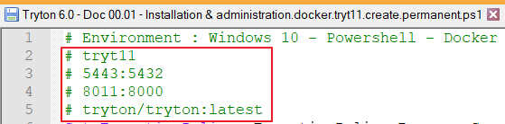
Installing containers built from « tryton/tryton » images with different « tags »
Docker shines thanks to its capability to isolate containers from one another, especially when such containers are generated from an « image » == « application » having different « tags » == « versions ». F.i. :
Image for version « 5.0 » or « 6.0 » : « tryton/tryton:5.0 » or « tryton/tryton:6:0 »
Image for version « latest » : « tryton/tryton:latest » or simply « tryton/tryton »
In order to generate containers according to the « image+tag » they are derived from, adapt the parameters identified in the choosen « create » utility script. Just perform a « replace all » of :
« tryt11 » : Container, database « names »
« 5443 » : the database port on the host system side & « 8011 » : the tryton port on the host system side
For simplicity, if the name is « 11 », we added « 11 » to default ports « 5432 » and « 8000 »
« tryton/tryton:latest » : change if necessary
Finally adapt some environment variables and volume locations according to taste

Slide 49
System Reboot

Slide 50
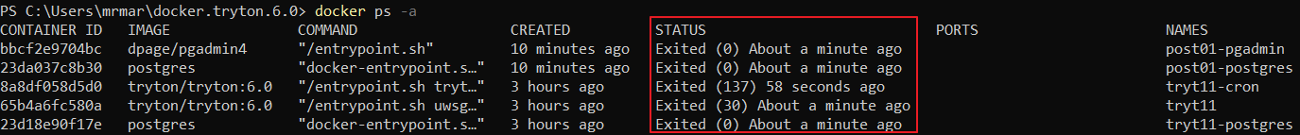
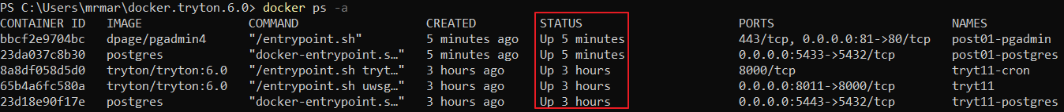
After Reboot
Each time the PC is rebooted, we need to execute the following commands in Powershell
docker ps -a # Control the status
# Start the containers docker start tryt11-postgres tryt11 tryt11-cron
docker start post01-postgres post01-pgadmin
Above commands are unnecessary when the PC is set to “Sleep”

Slide 51
User Interface

Slide 52
PgAdmin4

Slide 53
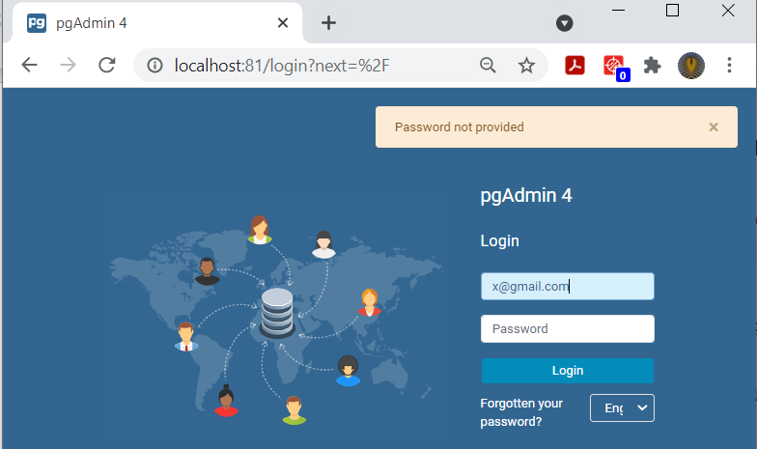
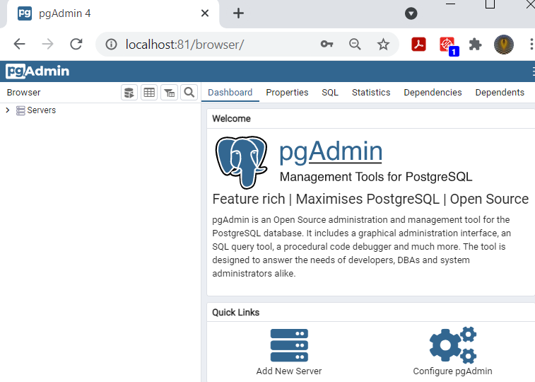
pgAdmin4
Note :
User : « x@gmail.com » is the address used in the script
Password : « Password » is the password defined in the script

Slide 54
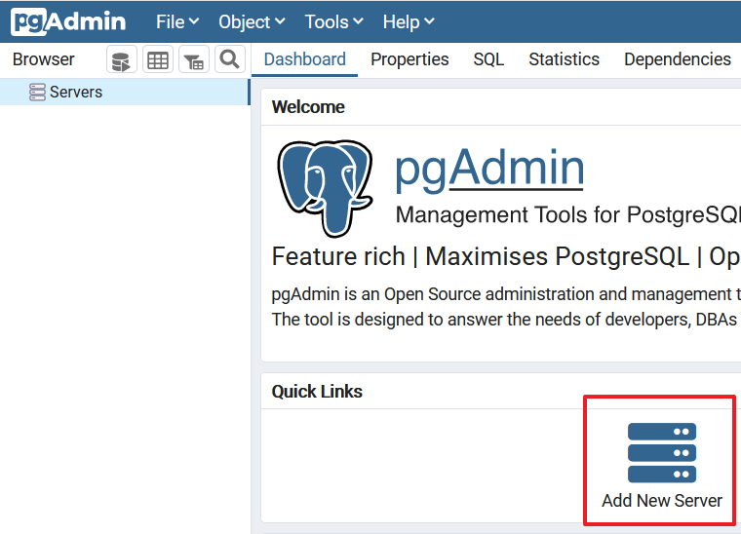
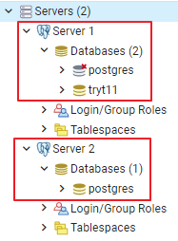
Create servers to connect to the databases
We define hereafter the following server(s) :
Server 1 : for access to the « Tryton » Database Container
Server 2 : if we created the optional « Postgres » Database Container

Slide 55
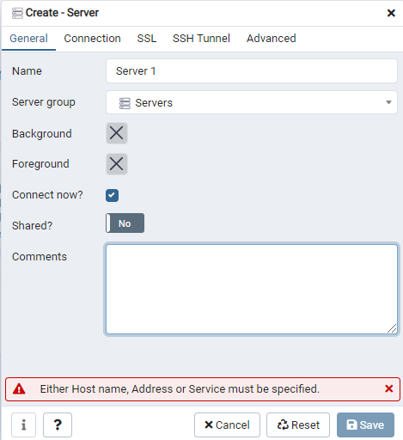
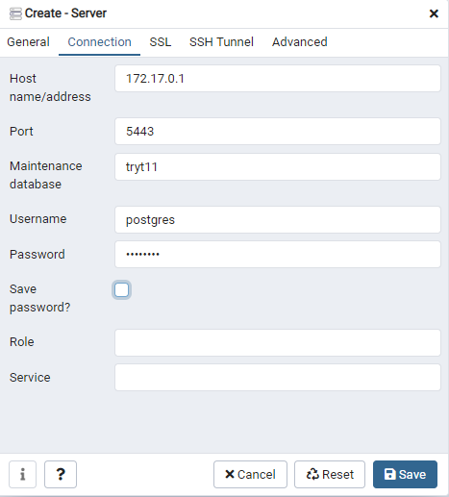
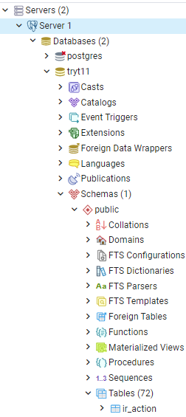
Server 1 - Connect to « tryt11 » database in « tryt11-postgres » container

Slide 56
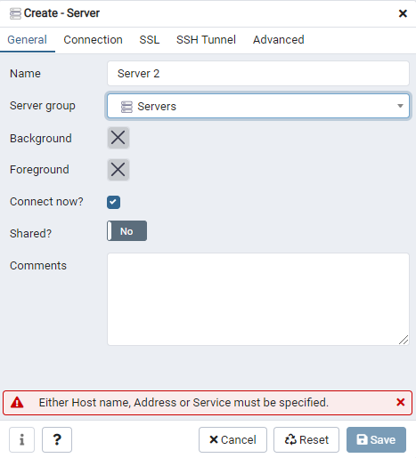

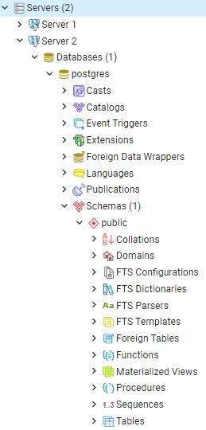
Server 2 - Connect to « postgres » database in « post01-postgres » container

Slide 57
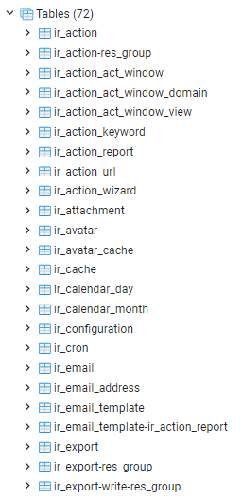
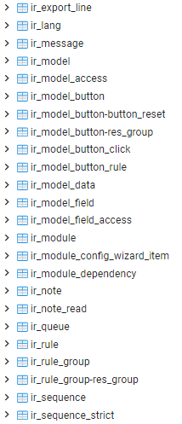
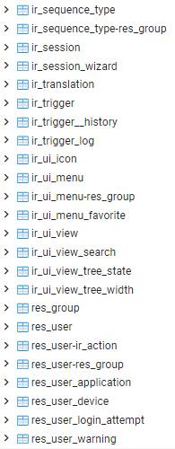
« Tryton » - Initial Database State
Only « ir » & « res » tables are installed

Slide 58
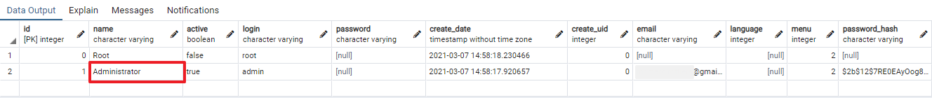
« Tryton » - Initial Database State

Slide 59
Tryton

Slide 60
Login / Logout

Slide 61
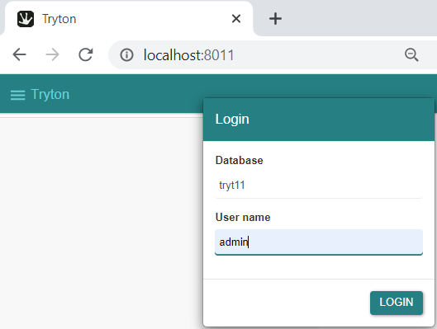
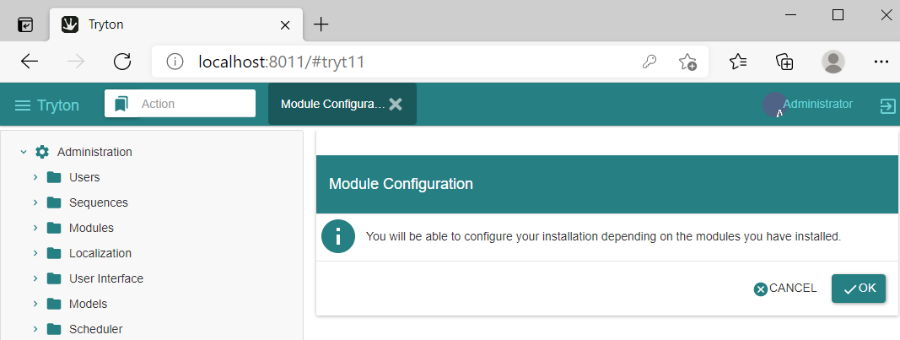
Tryton Login
In this introductory document, all operations are performed with user « admin » and password « Password » at login.

Slide 62
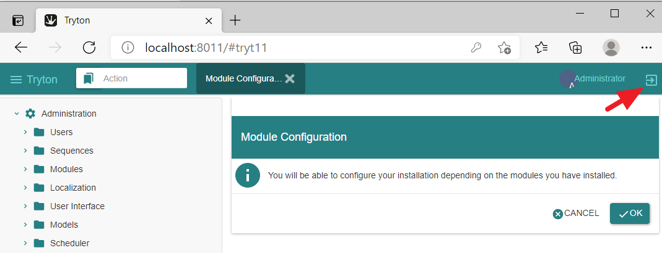
Tryton Logout
It is compulsory to « logout » prior to performing database backup / restore operations (cache usage)

Slide 63
Database Operations

Slide 64
Tryton

Slide 65
./"Tryton 6.0 - Doc 00.01 - Installation & administration.database.tryt11.query"
# container : tryt11-postgres
# database : tryt11
Set-ExecutionPolicy -ExecutionPolicy Bypass -Scope CurrentUser
#
Write-Host "---------"
Write-Host "1. Select"
Write-Host "---------"
docker cp query.dbms_01.sql tryt11-postgres:/inpu.sql
#
Write-Host "---------"
Write-Host "2. Access"
Write-Host "---------"
docker exec -it tryt11-postgres psql -d tryt11 -U postgres -P pager=off -f inpu.sql -o outp.txt
docker cp tryt11-postgres:/outp.txt query.dbms_02.txt
*.sql
query.dbms_01.sql | list of tables with row count
query.dbms_02.sql | list of pk-fk table relationships
query.res_user.sql | list of 'res_user' table rows (example)

Slide 66
Postgres

Slide 67
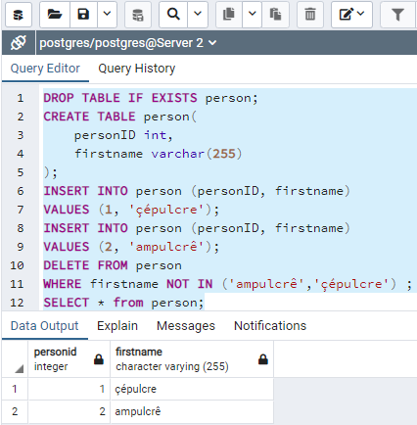
Populate a sample UTF8 table to verify backup/restore correctness
DROP TABLE IF EXISTS person;
CREATE TABLE person(
personID int,
firstname varchar(255)
);
INSERT INTO person (personID, firstname)
VALUES (1, 'çépulcre');
INSERT INTO person (personID, firstname)
VALUES (2, 'ampulcrê');
DELETE FROM person
WHERE firstname NOT IN ('ampulcrê','çépulcre') ;
SELECT * from person;

Slide 68
Scripts

Slide 69
Scripts
TRYTON Database Powershell Commands - Run as ./"..."
Tryton 6.0 - Doc 00.01 - Installation & administration.database.tryt11.backup | Backup
Tryton 6.0 - Doc 00.01 - Installation & administration.database.tryt11.restore | Restore
Tryton 6.0 - Doc 00.01 - Installation & administration.database.tryt11.query | Query tables
POSTGRES Database Powershell Commands - Run as ./"..."
Tryton 6.0 - Doc 00.01 - Installation & administration.database.post01.backup | Backup (3 modes)
Tryton 6.0 - Doc 00.01 - Installation & administration.database.post01.restore.* | Restore
Tryton 6.0 - Doc 00.01 - Installation & administration.database.post01.query | Query tables

Slide 70
Database Backup

Slide 71
Motivation
Explaining how to perform database dump and restore for a database managed inside a container
Ensuring that these operations preserve UTF8 encoding

Slide 72
Documentation
List of options | http://manpages.ubuntu.com/manpages/trusty/man1/pg_dump.1.html
How to | http://postgresguide.com/utilities/backup-restore.html
 | https://simkimsia.com/how-to-restore-database-dumps-for-postgres-in-docker-container/
 | https://stackoverflow.com/questions/24718706/backup-restore-a-dockerized-postgresql-database
Help | pg_dump --help

Slide 73
Tryton

Slide 74
./"Tryton 6.0 - Doc 00.01 - Installation & administration.database.tryt11.backup"
Set-ExecutionPolicy -ExecutionPolicy Bypass -Scope CurrentUser
#
Write-Host "---------"
Write-Host "1. Status"
Write-Host "---------"
docker exec -tiu postgres tryt11-postgres psql -c '\l+'
# Step 2 : dump tryt11
Write-Host "-------"
Write-Host "2. Dump"
Write-Host "-------"
docker exec tryt11-postgres pg_dump -Ft -U postgres -O -f tryt11-db-backup.tar tryt11
# Step 3 : export outside container (optional ; specifically use if later import in another container)
Write-Host "---------------------------------"
Write-Host "3. Export 'tar' outside container"
Write-Host "---------------------------------"
docker cp tryt11-postgres:/tryt11-db-backup.tar tryt11-db-backup.tar
#
Write-Host "-------"
Write-Host "4. Done"
Write-Host "-------"
Pause

Slide 75
Postgres

Slide 76
Postgres - Backup - Redirection - Incorrect result
Note :
The “tryt11-postgres” container contains two databases : “postgres” and “tryt01”
The “post01-postgres” container (if installed) contains one database : “postgres”
docker exec post01-postgres pg_dump -C -c -U postgres -O postgres > post01-db-backup.sql docker exec post01-postgres pg_dump -Fc -U postgres -O postgres > post01-db-backup.bak docker exec post01-postgres pg_dump -Ft -U postgres -O postgres > post01-db-backup.tar
Above file content redirections generate incorrect results with respect to UTF-8 characters
File assignment must be used (see hereafter)

Slide 77
./"Tryton 6.0 - Doc 00.01 - Installation & administration.database.post01.backup"
#
Write-Host "-------"
Write-Host "2. Dump"
Write-Host "-------"
docker exec post01-postgres pg_dump -C -c -U postgres -O -f post01-db-backup.createYes.sql postgres # includes database create commands
docker exec post01-postgres pg_dump -c -U postgres -O -f post01-db-backup.createNot.sql postgres # coes not include such commands
docker exec post01-postgres pg_dump -Fc -U postgres -O -f post01-db-backup.bak postgres
docker exec post01-postgres pg_dump -Ft -U postgres -O -f post01-db-backup.tar postgres
docker exec post01-postgres ls -l
#
Write-Host "---------------------------------"
Write-Host "3. Export 'tar' outside container"
Write-Host "---------------------------------"
docker cp post01-postgres:/post01-db-backup.createYes.sql post01-db-backup.createYes.sql
docker cp post01-postgres:/post01-db-backup.createNot.sql post01-db-backup.createNot.sql
docker cp post01-postgres:/post01-db-backup.bak post01-db-backup.bak
docker cp post01-postgres:/post01-db-backup.tar post01-db-backup.tar

Slide 78
Database Restore

Slide 79
Tryton

Slide 80
./"Tryton 6.0 - Doc 00.01 - Installation & administration.database.tryt11.restore"
Log out the system if you happen to be signed in
# Step 1 : docker stop/start containers
Write-Host "-------------------------------"
Write-Host "1. Docker stop/start containers"
Write-Host "-------------------------------"
docker stop tryt11-postgres tryt11
docker start tryt11-postgres tryt11
# Step 3 : drop and create tryt11-copy
Write-Host "------------------------------"
Write-Host "3. Drop and create tryt11-copy"
Write-Host "------------------------------"
docker exec tryt11-postgres dropdb -f -U postgres tryt11-copy
docker exec tryt11-postgres createdb -U postgres -T template0 tryt11-copy
# Step 4.1 : import inside container (optional ; function of step 1.2 above)
Write-Host "----------------------------"
Write-Host "4.1. Import inside container"
Write-Host "----------------------------"
docker cp tryt11-db-backup.tar tryt11-postgres:/tryt11-db-backup.tar
# Step 4.2 : restore tryt11-copy from tryt11
Write-Host "------------------------------------"
Write-Host "4.2. Restore tryt11-copy from tryt11"
Write-Host "------------------------------------"
docker exec -i tryt11-postgres pg_restore -Ft -U postgres -d tryt11-copy -v ./tryt11-db-backup.tar

Slide 81
Postgres

Slide 82
./"Tryton 6.0 - Doc 00.01 - Installation & administration.database.post01.restore.binary"
# Step 1 : docker stop/start containers
Write-Host "-------------------------------"
Write-Host "1. Docker stop/start containers"
Write-Host "-------------------------------"
docker stop post01-postgres post01
docker start post01-postgres post01
# Step 3 : drop and create post01-copy
Write-Host "------------------------------"
Write-Host "3. Drop and create post01-copy"
Write-Host "------------------------------"
docker exec post01-postgres dropdb -f -U postgres post01-copy
docker exec post01-postgres createdb -U postgres -T template0 post01-copy
# Step 4.1 : import inside container (optional ; function of step 1.2 above)
Write-Host "----------------------------"
Write-Host "4.1. Import inside container"
Write-Host "----------------------------"
docker cp post01-db-backup.tar post01-postgres:/post01-db-backup.tar
# Step 4.2 : restore post01-copy from post01
Write-Host "------------------------------------"
Write-Host "4.2. Restore post01-copy from post01"
Write-Host "------------------------------------"
docker exec -i post01-postgres pg_restore -Ft -U postgres -d post01-copy -v ./post01-db-backup.tar

Slide 83
./"Tryton 6.0 - Doc 00.01 - Installation & administration.database.post01.restore.character.createNot"
The « sql » file does not contain database drop & create statements
# Step 1 : docker stop/start containers
Write-Host "-------------------------------"
Write-Host "1. Docker stop/start containers"
Write-Host "-------------------------------"
docker stop post01-postgres post01-pgadmin
docker start post01-postgres post01-pgadmin
# Step 3 : drop and create post01-copy
Write-Host "------------------------------"
Write-Host "3. Drop and create post01-copy"
Write-Host "------------------------------"
docker exec post01-postgres dropdb -f -U postgres post01-copy
docker exec post01-postgres createdb -U postgres -T template0 post01-copy
# Step 4.1 : import inside container (optional ; function of step 1.2 above)
Write-Host "----------------------------"
Write-Host "4.1. Import inside container"
Write-Host "----------------------------"
docker cp post01-db-backup.createNot.sql post01-postgres:/post01-db-backup.createNot.sql
# Step 4.2 : restore post01-copy from post01
Write-Host "------------------------------------"
Write-Host "4.2. Restore post01-copy from post01"
Write-Host "------------------------------------"
docker exec -i post01-postgres psql -U postgres -d post01-copy -f post01-db-backup.createNot.sql

Slide 84
./"Tryton 6.0 - Doc 00.01 - Installation & administration.database.post01.restore.character.createYes"
The « sql » file contains database drop & create statements
# Step 1 : docker stop/start containers
Write-Host "-------------------------------"
Write-Host "1. Docker stop/start containers"
Write-Host "-------------------------------"
docker stop post01-postgres post01-pgadmin
docker start post01-postgres post01-pgadmin
# Step 2 : state
Write-Host "---------"
Write-Host "2. Status"
Write-Host "---------"
docker ps -a
Start-Sleep -Seconds 20 # Replace by detecting database is 'up'
docker exec -tiu postgres post01-postgres psql -c '\l+'
# Step 4.1 : import inside container (optional ; function of step 1.2 above)
Write-Host "----------------------------"
Write-Host "4.1. Import inside container"
Write-Host "----------------------------"
docker cp post01-db-backup.createYes.sql post01-postgres:/post01-db-backup.createYes.sql
# Step 4.2 : restore post01-copy from post01
Write-Host "------------------------------------------------------------------------------------------------"
Write-Host "4.2. Restore post01-copy from post01 [!!! DROP & CREATE inside 'post01-db-backup.createYes.sql']"
Write-Host "------------------------------------------------------------------------------------------------"
docker exec -i post01-postgres psql -U postgres -f post01-db-backup.createYes.sql

Slide 85
Multi-database Container

Slide 86
« Tryton Database Server » Container
« Tryton 6.0 - Doc 00.01 - Installation & administration.docker.tryt11.create.volatile or permanent »
The database container hosts a database server accessible with default port 5432:5432 (adaptable).
Initially, the database server is setup in the script to manage one database.
When performing database backup / restore operations it is prudent to :
Log out of TRYTON client
Double-check in the script whether the database and files need to be deleted or preserved

Slide 87
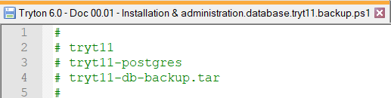

Backup a Tryton Database & Restore it to another name
./"Tryton 6.0 - Doc 00.01 - Installation & administration.database.tryt11.backup“
Use this script to backup the database initially created in the « Tryton Database Server »
In doing so, you have a « fresh » database that can be restored to another name inside the same container
./"Tryton 6.0 - Doc 00.01 - Installation & administration.database.tryt11.restore“
Use this script to restore a database backup in the « Tryton Database Server » container under another name
From this moment onwards, when login into TRYTON, a choice between two databases will be proposed

Slide 88
Next

Slide 89
Using Tryton
This follow-up documents explain how to use Tryton
Topics
Tryton 6.0 - Doc 00.01 - Installation & administration
Tryton 6.0 - Doc 05.01 - Basic functionality
Tryton 6.0 - Doc 10.01 - Purchase
Tryton 6.0 - Doc 15.01 - Sale
Tryton 6.0 - Doc 80.01 - Ancillaries

Slide 90
Issues

Slide 91
Known Issues
These are unresolved topics that relate to the presentation, not to the functioning of the system.
Document | Subject
Tryton 6.0 - Doc 00.01 - Installation | Waiting on Postgres DB to be ready

Slide 92
References

Slide 93
Various sources of documentation
Documentation Latest [https://docs.tryton.org/en/latest]
Docker Installation
https://hub.docker.com/r/tryton/tryton/
Classic Installation
[https://blog.lordvan.com/blog/tryton-setup-config/]
[https://www.akarei.cz/tryton/]
Administration Manual
[https://readthedocs.org/projects/tryton-administration-manual/downloads/pdf/latest/]
[https://tryton-administration-manual.readthedocs.io/_/downloads/en/latest/pdf/]
List of Modules [https://discuss.tryton.org/t/list-of-modules-and-what-they-do/2675/7]
Stock
[https://groups.google.com/g/tryton/c/H4ZqsJq37M8/m/W1TaVWu0AQAJ]
[https://docs.tryton.org/en/latest/stock.html#index-stock]

Slide 94
Various sources of documentation
Trytond Documentation [https://readthedocs.org/projects/trytond/downloads/pdf/latest/]
[https://trytond.readthedocs.io/en/latest/]
[https://tryton.readthedocs.io/en/latest/]
[http://hg.tryton.org/readthedocs/]
[https://docs.readthedocs.io/en/latest/subprojects.html]
[https://docs.readthedocs.io/en/latest/alternate_domains.html]

Slide 95
Other sources
Github [https://github.com/tryton]
Downloads
[https://downloads.tryton.org/]

